Slide 1
Social Studies 9
IN9.1 - Explain what Constitutes a Society

Slide 2
We’ve all heard the term “society” being used.
But what exactly does this word mean?

Slide 3
Get into groups of 3-4 and come up with your own definition for “society”.

Slide 4
What is a Society?
According to sociologists, a society is a group of people with common territory, interaction, and culture. Social groups consist of two or more people who interact and identify with one another.

Slide 5
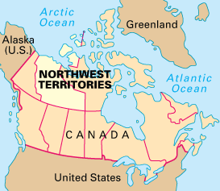
Territory
Most countries have formal boundaries and territory that the world recognizes as theirs. However, a society’s boundaries don’t have to be geopolitical borders, such as the one between the United States and Canada. Instead, members of a society, as well as non-members, must recognize particular land as belonging to that society.

Slide 6
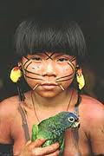
Territory Example
The society of the Yanomamo has fluid but definable land boundaries. Located in a South American rain forest, Yanamamo territory extends along the border of Brazil and Venezuela. While outsiders would have a hard time determining where Yanomamo land begins and ends, the Yanomamo and their neighbors have no trouble discerning which land is theirs and which is not.

Slide 7
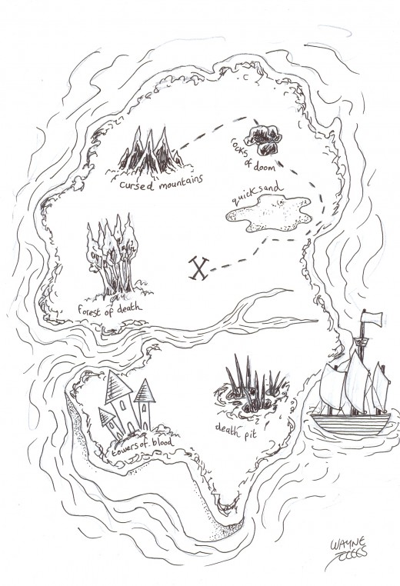
Territory
What is the territory of the society your group belongs to?
Do you belong to more than one society?
Sketch out the territory to two different societies you belong to:
1. A society you belong to with your group.
2. A society you belong to that your group didn’t mention.

Slide 8
Interaction
Members of a society must come in contact with one another. If a group of people within a country has no regular contact with another group, those groups cannot be considered part of the same society. Geographic distance and language barriers can separate societies within a country.

Slide 9
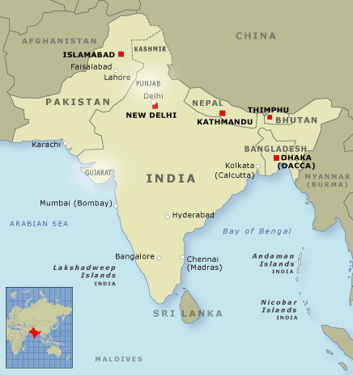
Interaction (Example)
Although Islam was practiced in both parts of the country, the residents of East Pakistan spoke Bengali, while the residents of West Pakistan spoke Urdu. Geographic distance, language differences, and other factors proved insurmountable. In 1971, the nation split into two countries, with West Pakistan assuming the name Pakistan and East Pakistan becoming Bangladesh. Within each newly formed society, people had a common culture, history, and language, and distance was no longer a factor.

Slide 10
2. Give an example of two sections/groups in Canada who do not have enough interaction with one another and could be considered separate societies.
1. Give an example a society that exists within Canada because of interaction.

Slide 11
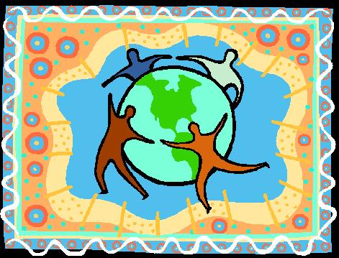
Culture
People of the same society share aspects of their culture, such as language or beliefs. Culture refers to the language, values, beliefs, behavior, and material objects that constitute a people’s way of life. It is a defining element of society.

Slide 12
Culture (Example)
Some features of American culture are the English language, a democratic system of government, cuisine (such as hamburgers and corn on the cob), and a belief in individualism and freedom.

Slide 13
Culture
In groups of 2 or 3, create a top ten list of things that are most symbolic of Canadian culture.

Slide 14
Assignment According to our definition of society, can ancient Mesopotamia be considered a society? In groups of three: i) Choose to examine either Sumerian or Babylonian civilization. ii) Find a map which depicts their distinct territory. iii) On what levels did this group interact with one another? iv) Do they have a distinct culture? Describe it.

